Slide 1
Group A: Facial Recognition
Kingson Zhang
Lance Pancha
Edgar Silerio

Slide 2
Introduction to Facial Recognition
Facial Recognition is a type of object detection.
Facial Recognition uses the defining features of a human face to recognize them.
Further training would be needed to recognize facial expressions and or moods.

Slide 3
Modern Applications
Smartphones
Using various instruments, Smartphones use facial recognition by comparing the face trying to unlock the phone with the one(s) used during setup.
Airports
Modern Airports utilize facial recognition to reduce wait times for those who have biometric passports such as epassports allowing them to reach their gate faster as well as aid in security.
Law Enforcement
Law enforcement collects mugshots of people arrested and uses facial recognition to compare them to various databases when conducting a criminal search.

Slide 4
The Hardware
Raspberry Pi: 3b+ or 4 versions as older models are likely not as powerful to handle the processing
Raspberry Pi camera module: Used to capture images to be processed
Intel Neural Compute Stick 2: Once trained the NCS2 does the bulk of the facial recognition processing

Slide 5
The Software
Raspbian OS: Functions as the main operating system and is what handles all hardware
Intel OpenVino: Through this program the Raspberry Pi interfaces with and programs the Neural Compute Stick 2.

Slide 6
Our Implementation
Install OpenVino
Set up the Environment Variables
Add USB Rules
Train the NCS2
Build the Program
Once the Program is built and the NCS2 is trained
Images are inputted
Output images are generated and faces detected are enclosed by Magenta boxes.

Slide 7
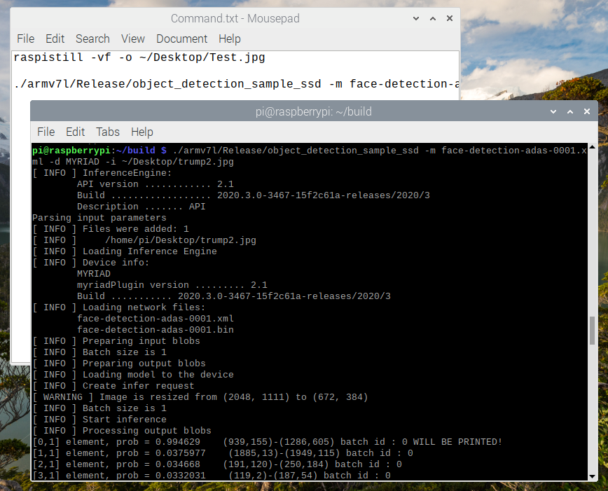
Running Facial Recognition Algorithm

Slide 8
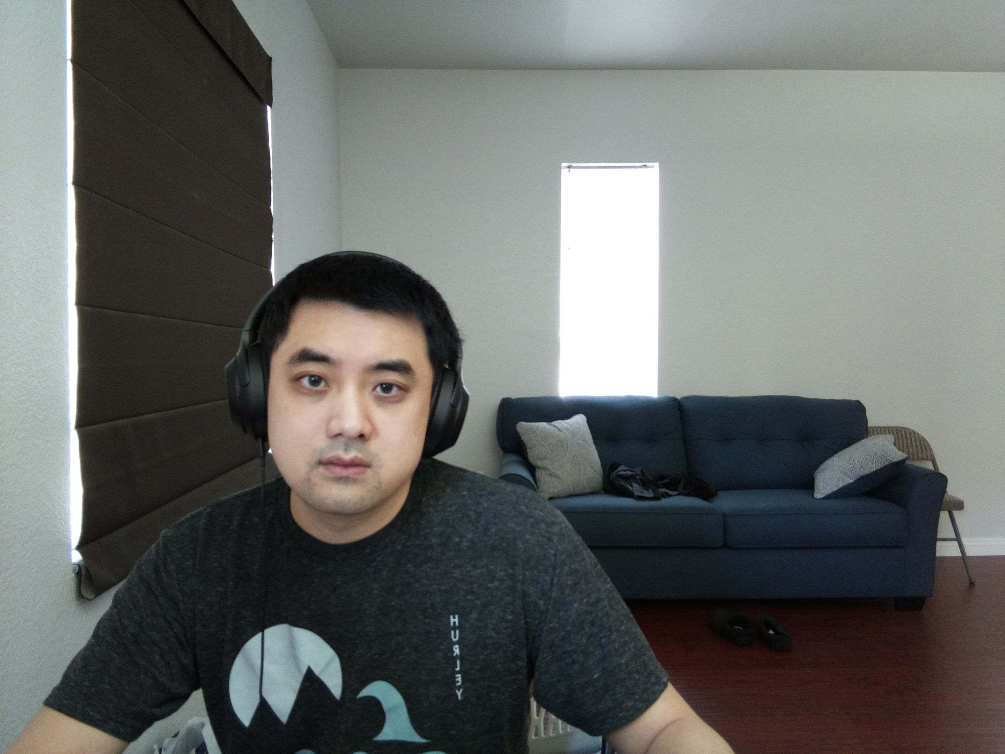
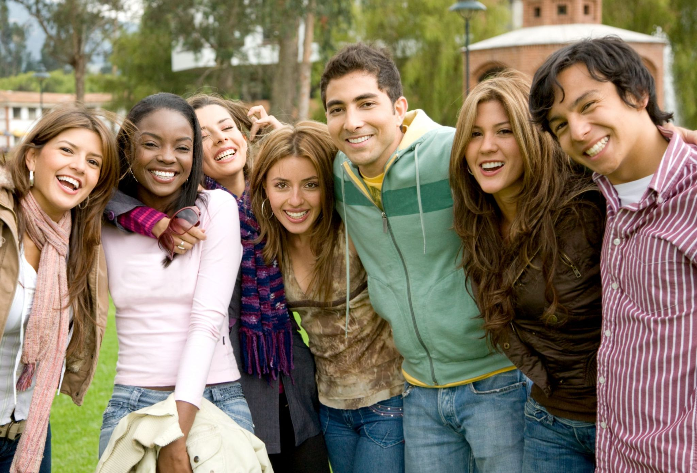
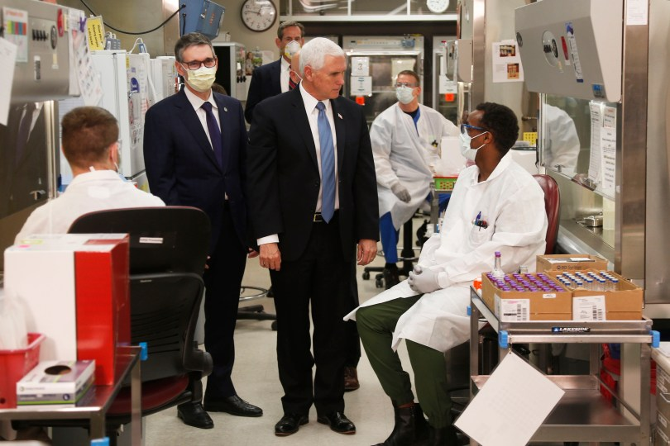
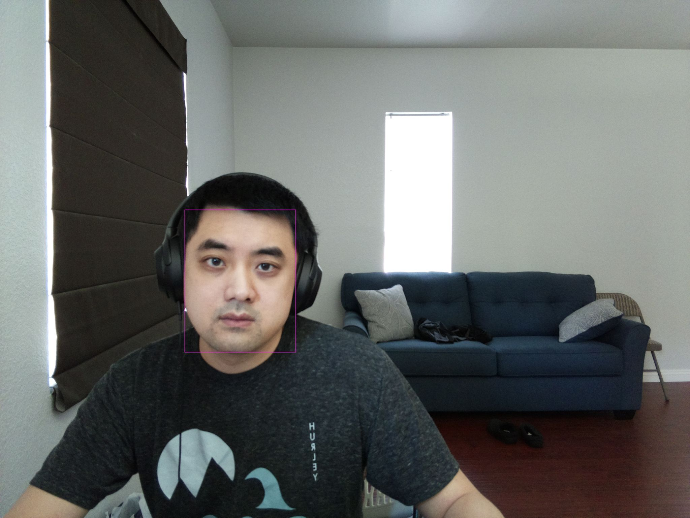
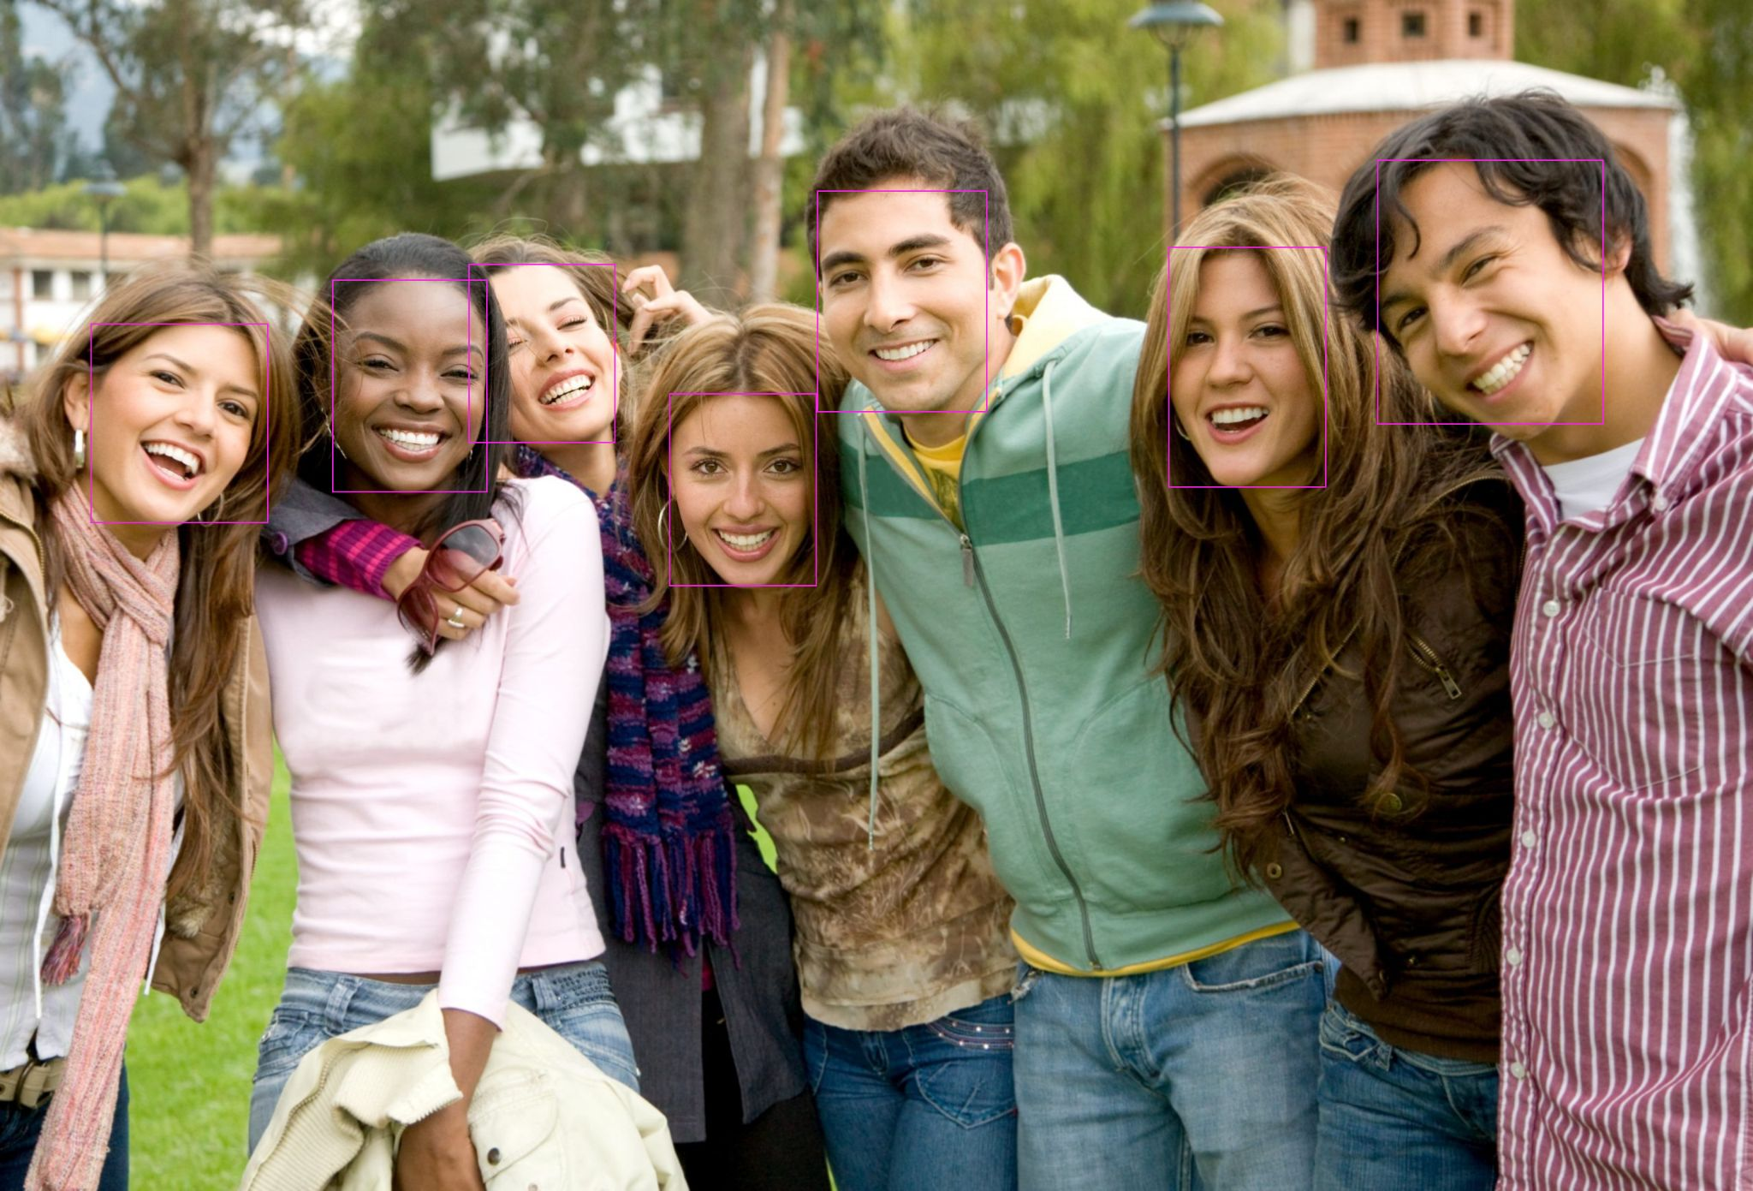

Examples

Slide 9
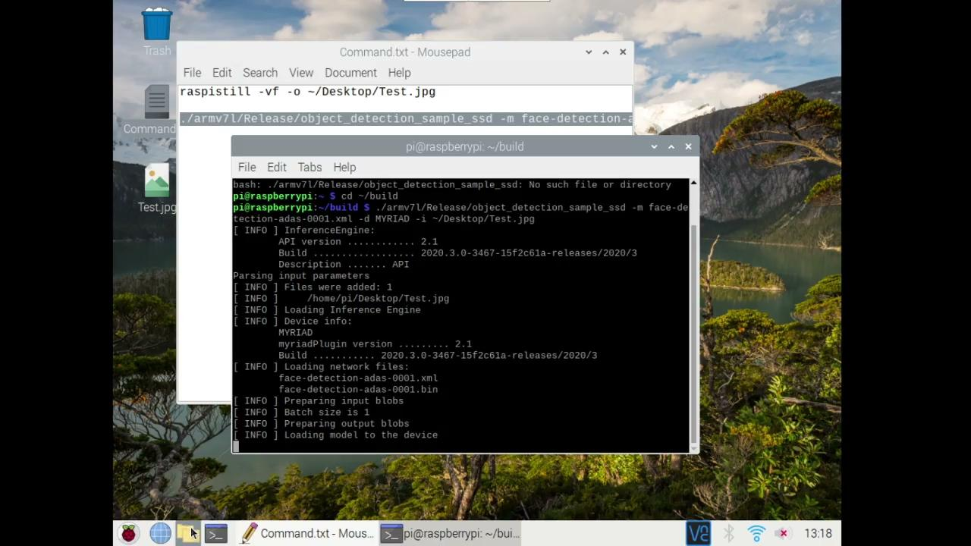
Demonstration

Slide 10
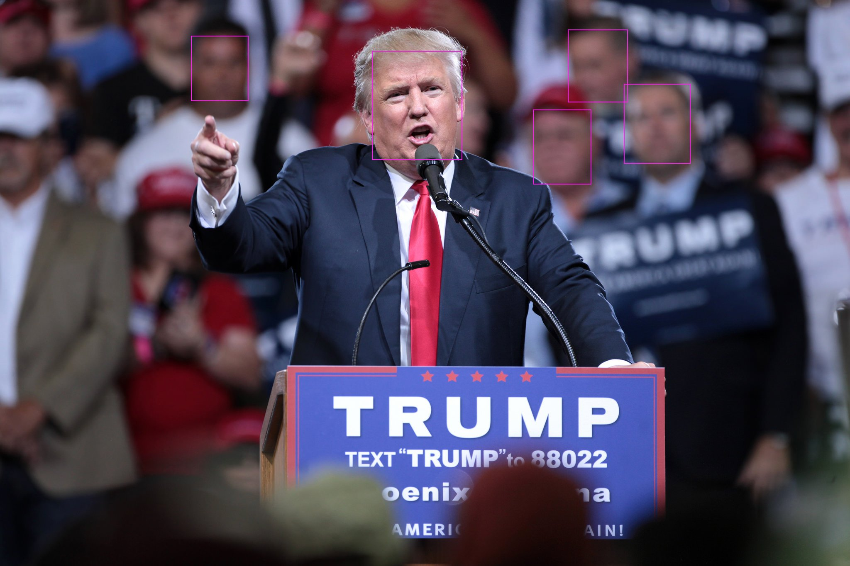


Results
Image Size: 1920x1080 1920x1080 2048x1365
Time Elapsed:
OpenVINO 2019 4.82 sec 4.85 sec 4.86 sec
OpenVINO 2020 2.86 sec 2.79 sec 3.22 sec
Successful Identification: NO NO YES…?

Slide 12
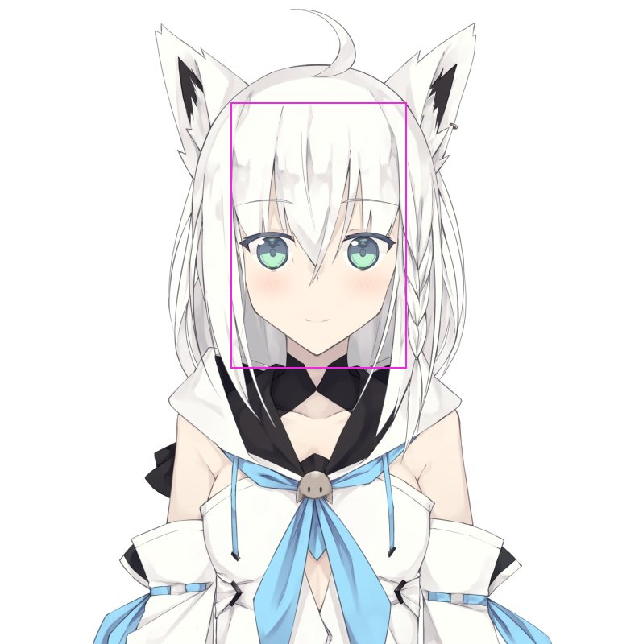
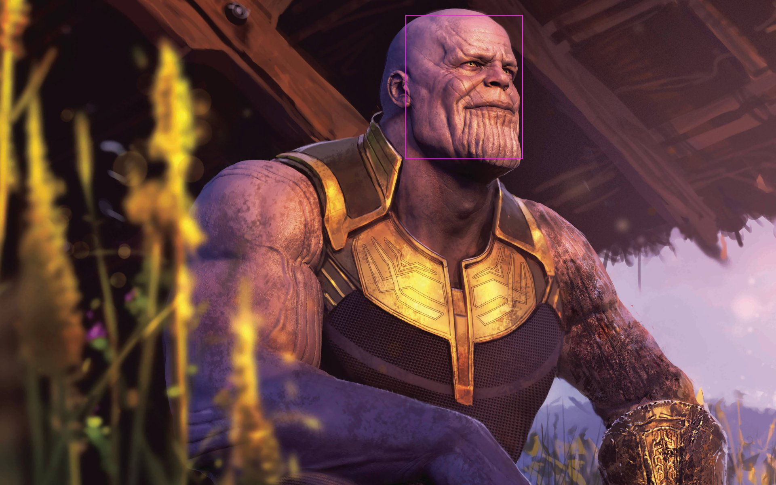
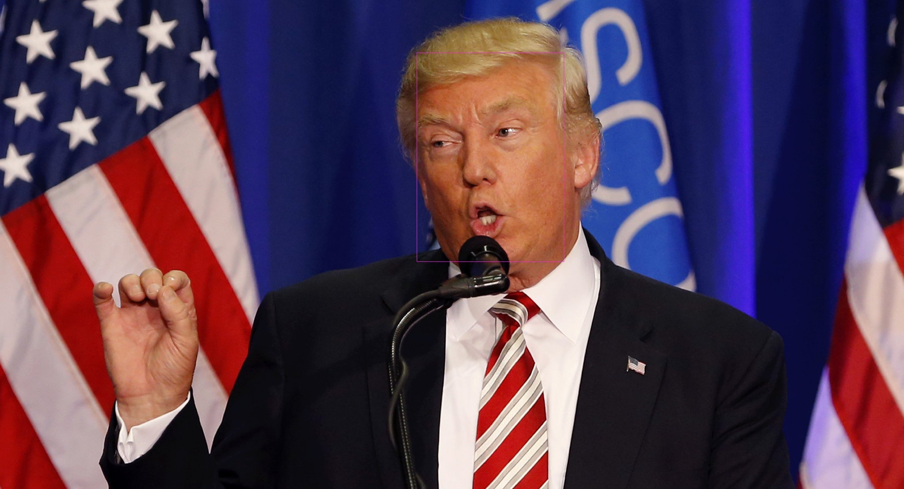
Results
Image Size: 790x800 1920x1080 4198x2277
Time Elapsed:
OpenVINO 2019 4.58 sec 5.12 sec 4.95 sec
OpenVINO 2020 2.68 sec 3.12 sec 4.18 sec
Successful Identification: YES YES YES

Slide 13
Sources
https://www.kaspersky.com/resource-center/definitions/what-is-facial-recognition
https://docs.openvinotoolkit.org/latest/openvino_docs_install_guides_installing_openvino_raspbian.html#run-inference-opencv
https://docs.openvinotoolkit.org/2019_R3/_docs_install_guides_installing_openvino_raspbian.html#run-sample
https://software.intel.com/content/www/us/en/develop/articles/intel-movidius-neural-compute-stick.html
https://movidius.github.io/blog/#:~:text=The%20Movidius%E2%84%A2%20Neural%20Compute,AI%20programming%20at%20the%20edge.&text=The%20Movidius%20Neural%20Compute%20Stick,inference%20applications%20at%20the%20edge.

